Slide 1
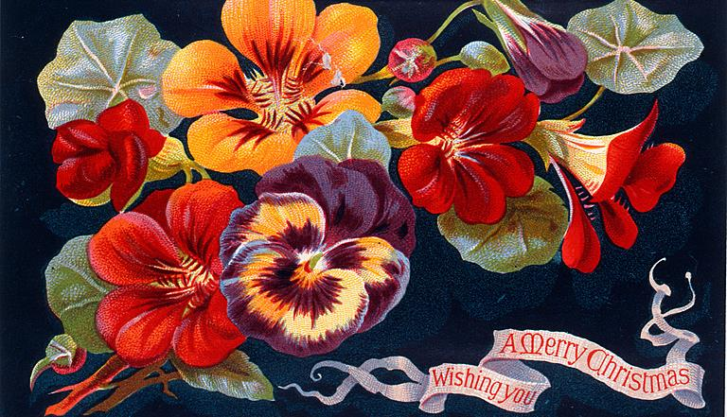
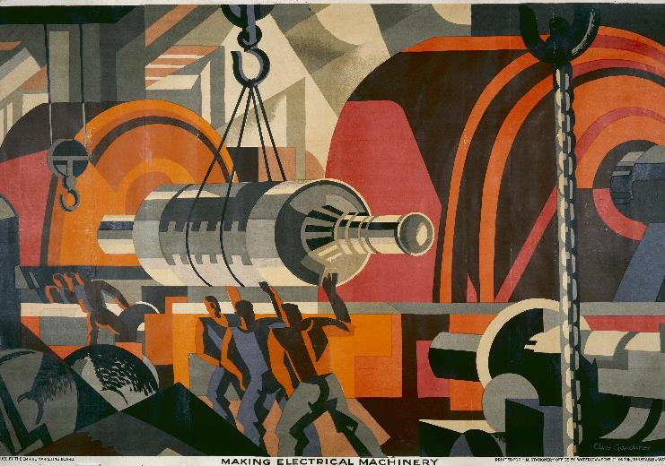

Chunks and Comparisons
25 September 2024
Notes:
This time I’ll start with a bit of a recap
Then I’ll talk about some new things I’ve done since last time
Couple of demos and a couple of exercises along the way
Slightly worried by how many slides I’ve produced, we might skip some bits!

Slide 2
TRIGGER WARNING
Slides 24 and 25 contain topics and subjects that surface racially offensive language.

Slide 3
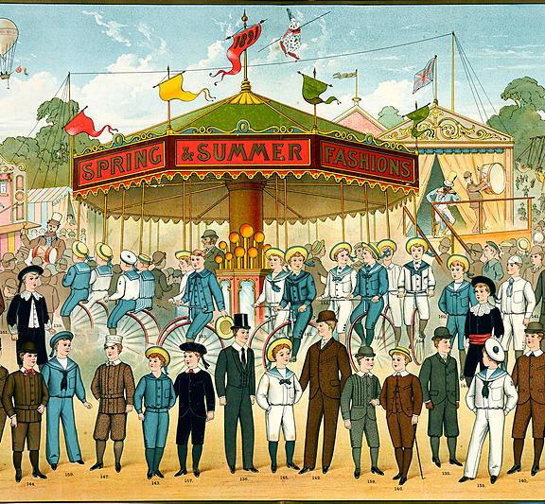
1. Recap

Slide 4
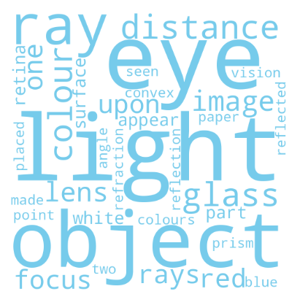
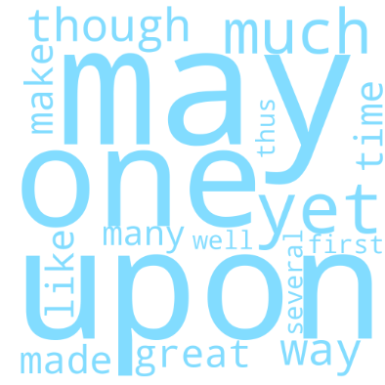
What is a topic model?
“... a somewhat hard to interpret topic that deals with men, little girls, god, black robes, and shouting...”
(Tangherlini & Leonard, 2013)
Notes:
The first thing to point out is that I’m still working with topic models
At some point I realised that using other techniques wasn’t very feasible in the available time, so this will be very much a “topic models” project
So a quick recap on what topic models are:
A statistical approach to words
In this case, looking at words individually
Looking for associations of words that indicate some meaningful topic
Unsupervised, so you just let the machine go and it tells you what it finds
It cannot tell you what the topics “mean”, just how they relate to words and text
So meaning is up to us
It is not necessarily obvious, for example:
“... a somewhat hard to interpret topic that deals with men, little girls, god, black robes, and shouting...” (Tangherlini & Leonard, 2013, https://doi.org/10.1016/j.poetic.2013.08.002)
They are often used for direct analysis (“this is how discussion of X changed over time in community Y)
But I’m a bit distrustful of this, more interested in them as a starting point for more traditional methods of research
In this case, curious about them for search
Topics can be represented in various ways
I’m using word clouds a lot
Sometimes the clouds look like they relate to some coherent topic, like the one on the left
Sometimes less so, like the one on the right

Slide 5
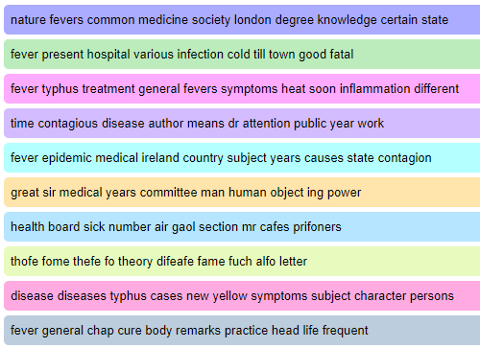
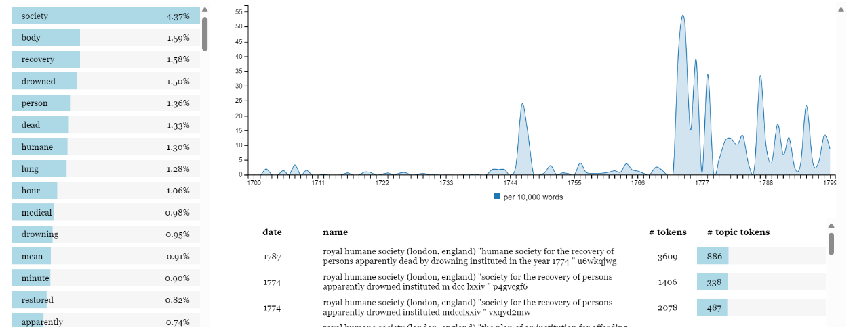
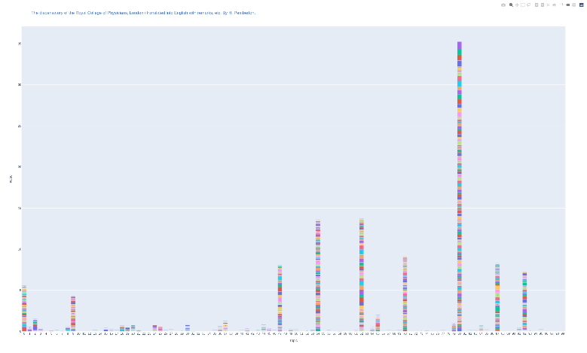
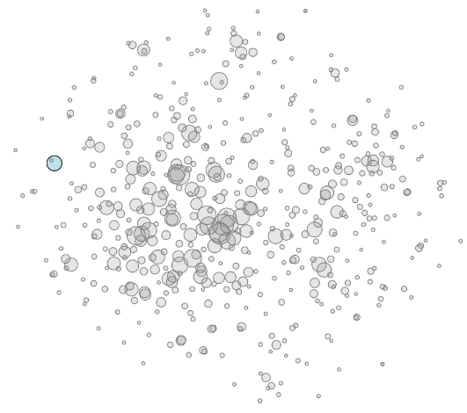
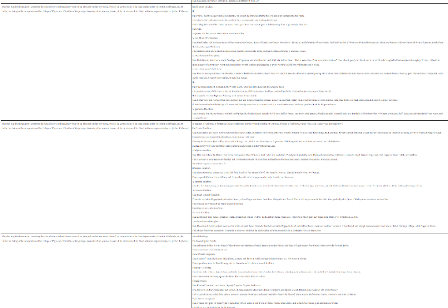
Various topic views
Notes:
Models can be analyzed and represented in many other ways, such as:
The top words with no information about proportion [Voyant]
More precise information about word proportion than the impression that a word cloud gives [HaToRI]
Prevalence of topic over time [HaToRI]
Importance of a single topic across different texts [HaToRI]
Or of different topics within a single text [Me]
Similarity of different topics [HaToRI]
The actual text that the topic was made from [Me]

Slide 6
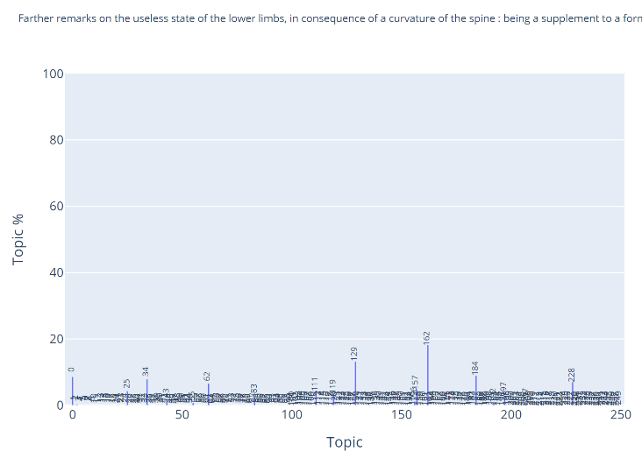
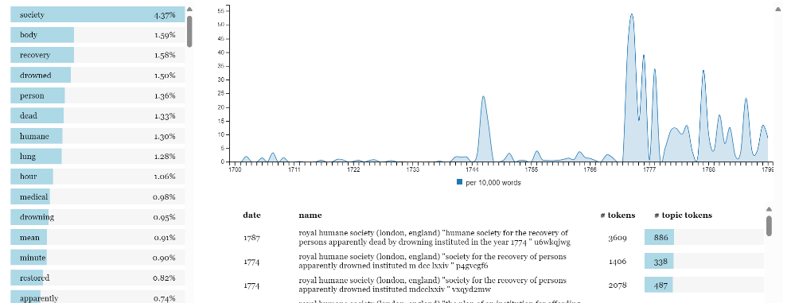
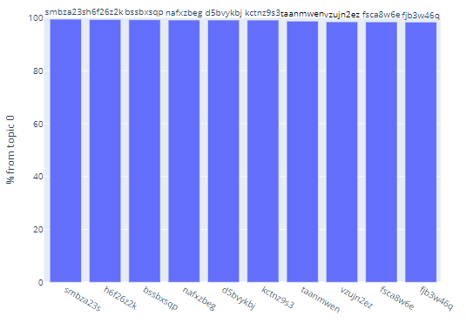
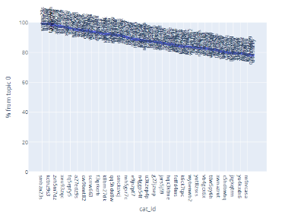
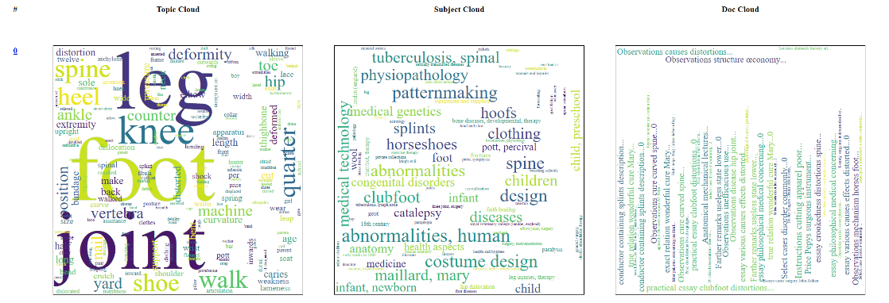
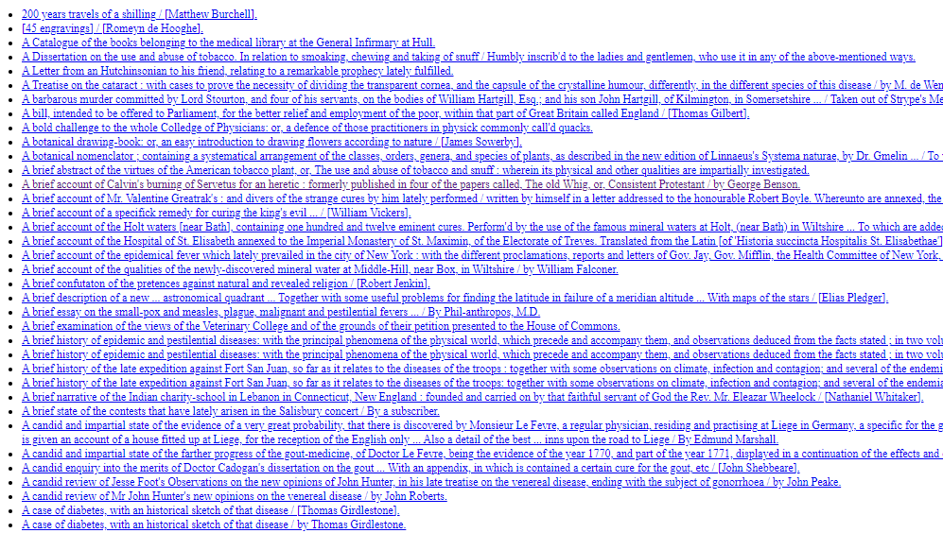


Recap
Notes:
Early on I showed you HaToRI
A tool to study Hansard through a topic model lens
Which I had repurposed to look at 18th century texts listed in the catalogue
Last time, I’d tried to go behind that interface a bit
And find a few other ways to look at the collection through a topic model view
So I threw HaToRI away and bodged together my own ways of looking at the data
Which sadly is less pretty and sophisticated
But easier for me to customise things this way
Changes last time included
Bringing in some information from the catalogue
And working with different model counts
So now I have 10, 50, 100, 250 and 500 topic views of the collection
Coarser and finer grained views of the collection

Slide 7
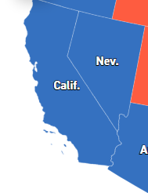
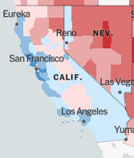
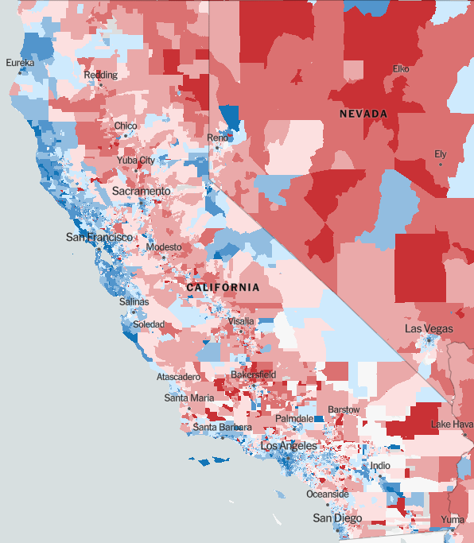
Granularity
Presidential Election Results 2020 | Live Map Updates | State Electoral Votes (politico.com)
An Extremely Detailed Map of the 2020 Election Results: Trump vs. Biden - The New York Times (nytimes.com)
Notes:
We can think of a small number of topics as giving us a distant view of main themes in the collection
And a larger number as giving us a closer, more detailed, granular view
I’ve tried to illustrate that by analogy here, with this 2020 US election map
From a distance we see that California and Nevada voted Democrat.
A closer, more granular view shows large blue and red chunks
And eventually a fine-grain view of the vote by individual “units”
Similarly, a 10 topic view of the collection is very coarse, we’re just the state level, to stretch the metaphor
At the other extreme, I hope that a 500 topic view will give a level of detail more like the one on the right here
Though it might instead just result in repeating topics
The “right” granularity depends upon the question you’re asking
For a relatively specific search like “material relevant to aging”, we would probably want the more granular models

Slide 8

Catalogue Data
Notes:
As well as trying different topic counts, I tried to bring in some of the catalogue data
I did this through word clouds, which may not have been the best way
So this is the main part of the current interface, unchanged from the last visit.
What you see here is a topic represented in 3 clouds:
Clouds like before, showing the relative importance of words making up the topic
A subject cloud, showing the relative importance of catalogue subjects in the topic
A document cloud, showing the most important documents to the topic
One thing to mention is that there are quite a lot of books with no subject
On my to-do list is generating topic models for those books
Potentially leading in the direction of auto-classification
The document cloud in particular is just not very helpful
The information seems to be useful
But this is very much not the ideal way to represent it
You can also see that these clouds are showing very small words
I was just talking about granularity in terms of number of topics
But this view of “words in topics” is also very fine grained, too much so
It may well be that these should be ignored as being below the threshold of significance

Slide 9
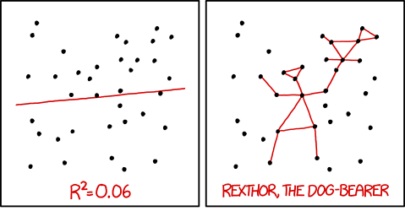
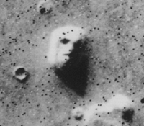
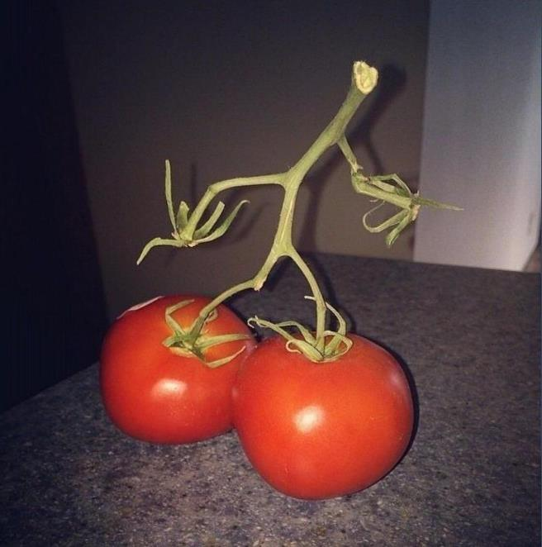

Imaginary Meaning
https://en.wikipedia.org/wiki/File:Martian_face_viking_cropped.jpg
https://forums.forteana.org/index.php?threads/pareidolia.55195/post-1787443
https://forums.forteana.org/index.php?attachments/g6gqjez6q9o11-jpg.11890/
Notes:
Looking at this many topics with lots of detail
And presenting them as word clouds
Is a bit worrying
Humans are really good at imagining structures and patterns
And sometimes we go too far with it
Here we have the face on mars and a sneaky person in big boots
And then a more data perspective from a webcomic, including:
You can use maths to tell yourself stories about data by fitting different kinds of line
Or you might, for example, see Rexthor the Dog-Bearer in a random pattern of dots
I think word clouds are quite prone to this sort of false patterning.
I suspect that I’m keying on certain words, it is hard to get an “objective” sense of what the most relevant words are.
I try to concentrate a bit when I look at them
I think its important to be skeptical, and to draw upon expert knowledge, in making sense of these things
That said, they do seem good for sort of high-level, fuzzy discovery.
Better suited to getting a feel for the terrain, suggesting ideas, than for detailed analysis
Alternative interfaces – e.g. the list view that HaToRI offered – may be better for more carefully analytical approaches
Different presentations of the data e.g. lists might be better for a more analytical comparison.

Slide 10
Demo 1
Notes:
So, I’ll quickly show you this “old stuff”, because I’m still using it for part of what I’ve brought today

Slide 11
So What’s New?
Notes:
So that was the recap.
Since then I’ve been fiddling around with a few things
Pulled works.json into a database, which makes working with metadata much more practical then using “normal” JSON tools on a gigantic JSON file
For example, makes it easier to filter out texts that are in the catalogue but not held by Wellcome
Or to make models of texts with no subject
Though I haven’t actually done either thing yet!
More relevant for today:
Tried modelling texts with and without named entities
Means that the modelling will see the text in different forms
Which could result in different models
Split texts up into smaller chunks and building topics based on those smaller chunks
It’s actually the smaller chunks where I think this gets more useful for search
Should result in topics that more accurately reflect the text that they are based upon
And take us directly to those bits of text, so that we can see whether they are relevant or not
For time reasons, did this just on texts from the 1750s
So today is somewhat about “comparing stuff”
Which leads me to one more caution
There are a few variables already
Different topic counts
Different processing of the text before we build the models (preprocessing)
Different corpora
This leads to an explosion of possibilities to look at, more than I can look at even in a shallow way
And it also means that where we observe some point of comparison, it can be difficult to know _why_ things are different

Slide 12
2. Comparisons Named entities and the lack thereof

Slide 13
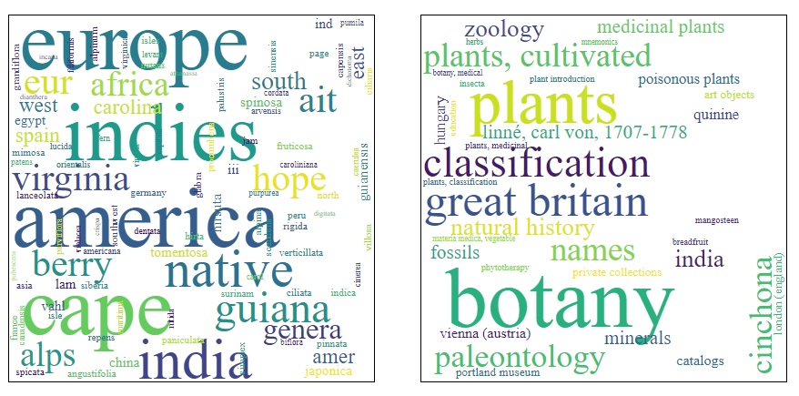
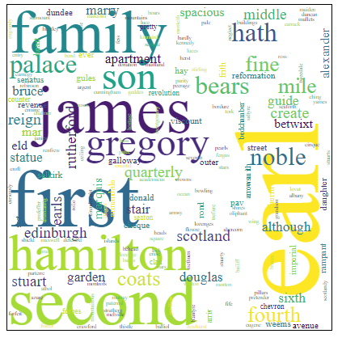
Named entities
Notes:
Named entities are, well, entities with names
Very broadly can think of these as proper nouns
But the scope can be wider than that, including e.g. monetary values, measures of quantity,
Was curious about the effect of taking at least proper nouns out
I think definitely in some cases named entities seem to tell us something
e.g. here on the top left perhaps this (topic, subject) cloud pair says something about the scope of botany
But perhaps they also mask things
Would I think this was a “botany” cloud if I did not have the “subject” cloud next to it?
On the other hand, might there be some “meaning” in this right-hand topic that would be more clear if names and titles weren’t dominating it?
As usual with this project, I’ve approached this in a very simple way – anything that spaCy considered a named entity got discarded
For particular kinds of research question you might want to discard only certain kinds of entity
Or discard everything _except_ certain kinds of entity
My guess is that just discarding _all_ named entities is too crude, but anyway we can have a look at the effect
[Can see a claimed list of SpaCey entity types, at some point in time, here: List of all supported Named Entities · explosion/spaCy · Discussion #9147 (github.com)]

Slide 14
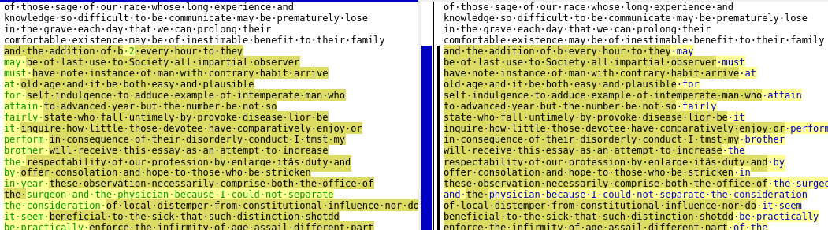
De-Entity-ed
An essay on the disorders of old age, and on the means for prolonging human life / by Anthony Carlisle.
Carlisle, Anthony, Sir, 1768-1840.
1818
https://wellcomecollection.org/works/xsqydfp4 (pp. 3-4, images 11-12)
Notes:
To show an example of entity removal, here is a screenshot from a text comparison tool
Don’t worry too much about all the highlighting, the important bits are the red boxes
The text on the left here is just before the entities are removed
It has already been through some transformations, but the entities are still there
The text on the right has entities removed
But so far as I can see the main effect here is that the number “2” (which is actually a page number, but the “B” goes with it) and the word “year” have been removed – but, curiously, not “hour”
Perhaps not the best example
But does emphasise that named entities are not necessarily just “proper nouns”
And that I should probably have been more discerning in what I stripped out
So there is some danger that what I have done here is largely to remove a few words at random
But assuming just for now that removing _all_ named entities somehow makes sense, what is the effect of doing so?

Slide 15
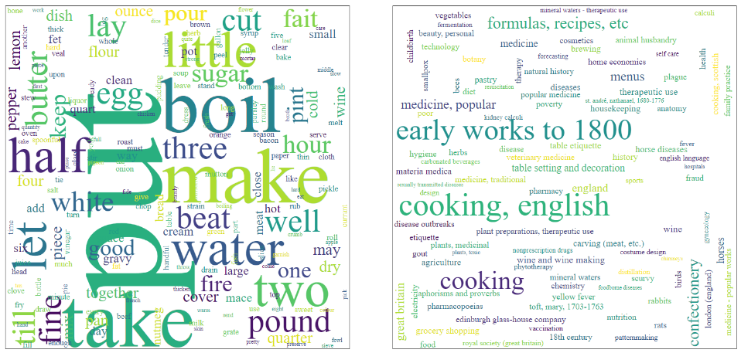
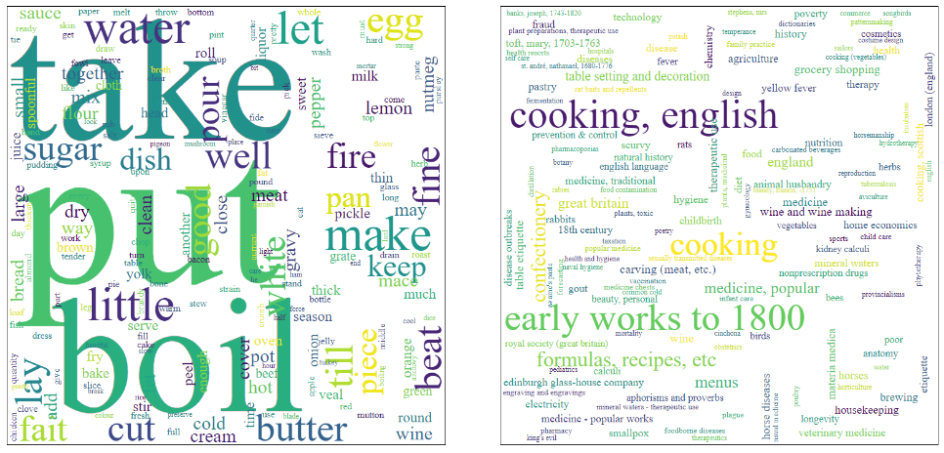
“Cooking”
10 lemmatized topics with named entities
Topic 1
10 lemmatized topics without named entities
Topic 8
Notes:
So that all took a while to explain
How much difference does it make if we remove the named entities?
In the 10-topic view of the corpus I think the answer is “not much”
But it is hard to be sure, it would take some time to analyze properly
I went through the 10 topic views with and without named entities and tried to get a sense of what they might mean
So 2 versions of the 10-topic view of the connection
But when I tried make connections between the topics in the two versions, some seemed similar to me
Let’s not do all 10, but a couple of examples
Here we have an example of a topic that looked very similar in both cases
Topic 8 is more differentiated – it has 3 very large words, then quite a gap to the smaller words
We could argue that it is more distinctive
But in terms of “what the topic is about”, feels about the same
So it is something like the same topic, with a different emphasis

Slide 16
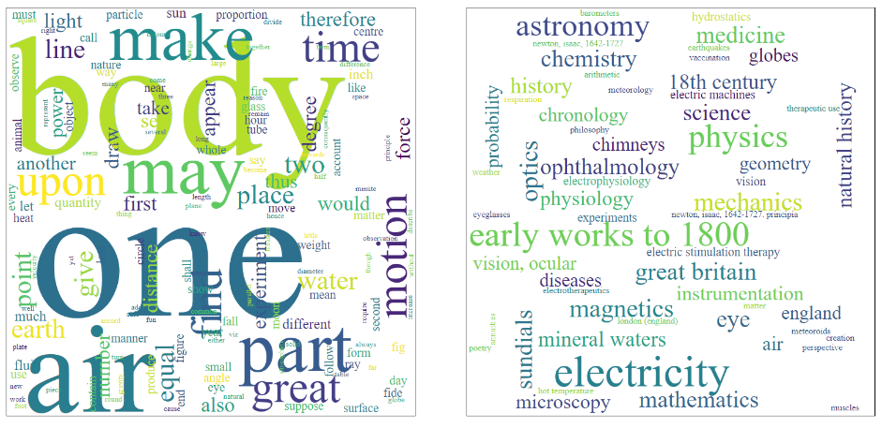
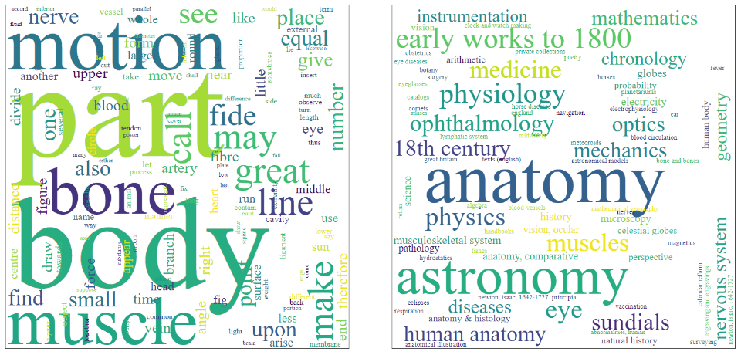
“Science?” “Anatomy?”
10 lemmatized topics with named entities
Topic 8
10 lemmatized topics without named entities
Topic 7
Notes:
These ones don’t seem connected
When looking through the 10 topics from each condition, they seemed more similar to one another than to any of the other possibilities
But I think they’re different really
The one on the left, with the named entities, feels more abstractly scientific
Both because of words like “time” and “motion” which, in combination with “body”, feel like physics
And because of the subject cloud
The one on the right seems from the topic to be more about anatomy
“motion” and “body” also fit with astronomy, which is also large in the cloud
And I suppose this could point to something meaningful, given the importance of astrology in the past
But my gut feeling is that it’ll turn out to be conincidental, more to do with those shared words
The document titles clouds, which I could not fit into this slide, are quite different
The ones that go with the left-hand topic sound very much like scientific treatises
The ones that go with the right-hand topic sound very much like anatomy specifically
So the entity removal seems to make a real difference here – there is no “anatomy” in the “with entities” list, and no “science” in the “without entities” list

Slide 17
Exercise: Entities vs No-entities
Notes:
So you can use handouts or the web interface for this
For looking at a bunch of topics at once, I do think the paper can be easier
The exercise is just to compare “with entities” and “without entities” topics, looking for similarities and differences
I’ve annotated the paper ones with my labels and which topic in the “other” list seemed most similar
While you’re doing it, please think about
How you’re going about the comparison
What else you would need to do the comparison properly, e.g.
Access to the texts themselves
More information about the texts in the cloud (if so, what?)
Different tools, interfaces, visualisations

Slide 18
Entities vs Non-Entities
How you’re going about the comparison
What else you would need to do the comparison properly, e.g.
Access to the underlying texts
More information about the texts in the cloud
Different tools, interfaces, visualisations

Slide 19
3. Chunks The 1750s, 500 words at a time
Notes:
Everything so far has been dealing with a “whole 18th century” corpus
And topics have been built by feeding the modeller whole texts at a time
I read somewhere that very small chunks of text are best for topic modelling
I don’t know how true this is, but certainly it would be useful for search if we were working with a finer grain than “whole book”
We need to be able to find relevant passages within what might be much larger texts
And if it is really to be useful, passages that you wouldn’t guess were there from the catalogue description
So I chunked everything up into units of 500 words
My data pipeline ground to a halt in the face of almost 1,000,000 little files

Slide 20
Mini-Corpus: The 1750s
312 texts
29,000 500-word chunks
14.5 million words
Stemmed
Kept named entities
Everything with a 4-digit date beginning “175”
Still including any non-Wellcome texts
Notes:
So I knocked together a much smaller corpus – just texts from the 1750s
Chunked that up, and stemmed (rather than lemmatized) the chunks
Stemming is much much quicker
So I can show you the result of that... but I suspect that the very much smaller corpus is having an effect upon what we see
There is a computer in Kew chugging through lemmatization of this smaller subset as we speak...

Slide 21
Word Spread
Notes:
“Max words” because this is 500 times number of chunks – the final chunk of each text will be smaller
Mostly in the 500 – 100,000 word range, with a few outliers rising to one text with over 0.5 million words
I’ve drawn a second graph of word counts for just the texts in the up to 100,000 range

Slide 22
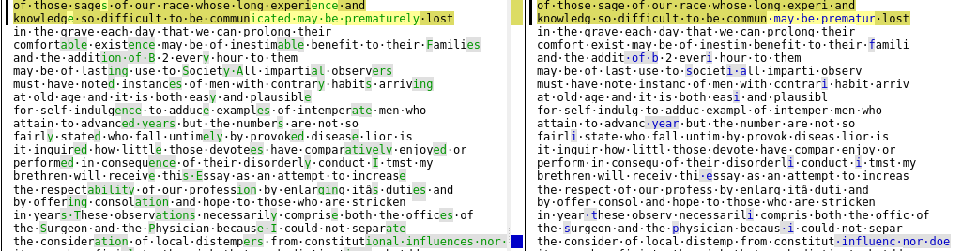
Stemmed
An essay on the disorders of old age, and on the means for prolonging human life / by Anthony Carlisle.
Carlisle, Anthony, Sir, 1768-1840.
1818
https://wellcomecollection.org/works/xsqydfp4
Notes:
I mentioned the text was stemmed
This is the “quick way” to try to ignore differences between different forms of words
So this is what stemming looks like
Original on left, stemmed on right
Just point out a few differences
4th line, “comfortable” and “existence” have become comfort and exist – probably a lemmatizer would do the same
5th line, “addition” -> “addit”
5th line, “every” -> “everi”... which seems to be how this stemmer deals with a trailing ‘y’
It is obvious in the topic clouds that we are dealing with stemmed texts

Slide 23
Demo 2
Notes:
I fiddled around with the visualisations a little bit to try to deal with these smaller text chunks, so I’ll show you that now
So for the rest of this, remember that we have changed a few things at once:
The corpus is much smaller
We are working in chunks of 500 words, not whole texts with lengths of many times that
The text is stemmed, not lemmatized

Slide 24
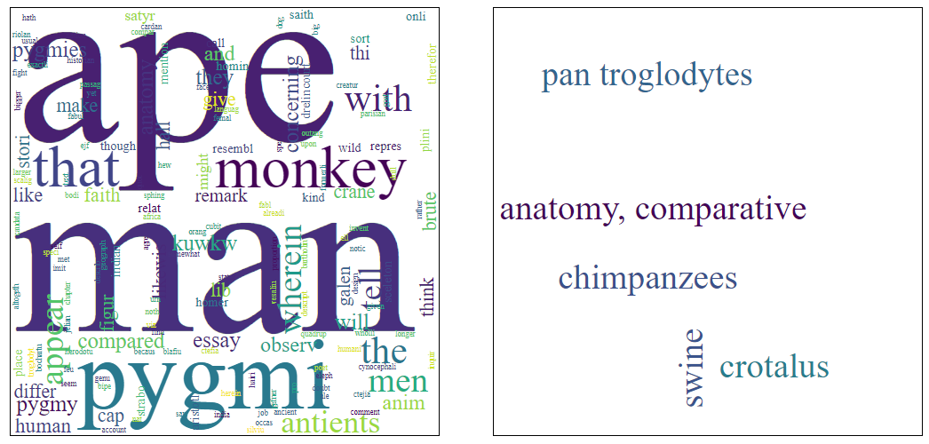
Simple, single-text clouds
Notes:
One thing that jumped out when in this interface is that some of the subject clouds are much more simple
It would be nice to think that we have computationally discovered a cataloguers classification of the collection
That would suggest that this really is a “real” topic, referring to a meaningful subject
And I did hope that that was what it meant
But sadly, it seems just to mean that the topic is really dominated by 1 or 2 books
As far as I can tell with the tools that I have – the table view is not so helpful for figuring this out
Single-book topics do not seem very helpful for search
But their existence does at least suggest that the algorithm is doing something meaningful
Numerous 500 word chunks from a single book are getting assigned to the same topic
So at least it is correct that they are in some sense about the same thing
This also again highlights that the “document title” cloud is not helpful [next slide]

Slide 25
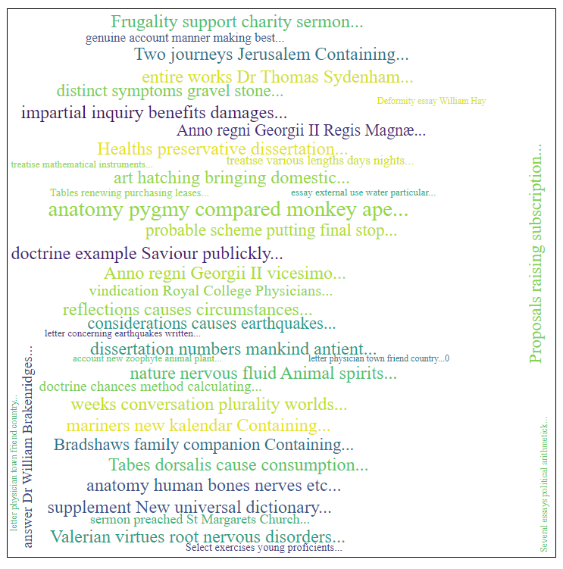
Simple, single text clouds (2)
Notes:
Here it is
I’ve highlighted the book that very much seems to dominate (its full title is very offensive to modern eyes, happens to be abbreviated here)
If this was giving the right impression, I think that the title would be either alone here, or at least very very large compared to the others
So here digging a bit deeper seems to expose a misleading-ness in the visualisation

Slide 26
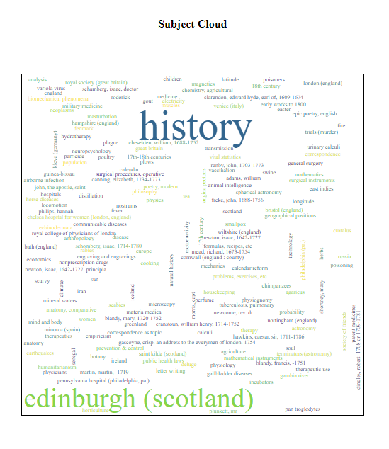
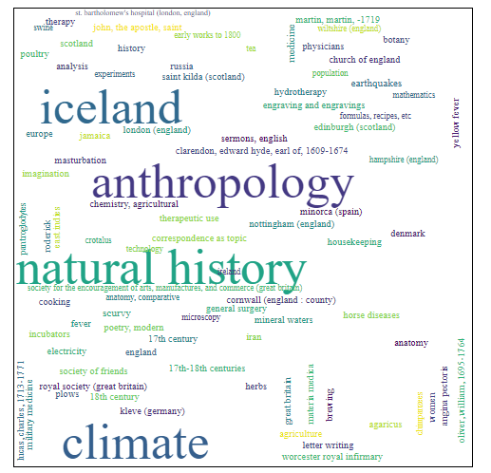
More “single book” clouds
Notes:
Sometimes it is not so much that the cloud is empty, as that very few subjects are now dominant
But the cause still seems to be domination by a single book
So, some of the subject clouds seem to make “more sense”
But that’s just because they happen to be reflecting the classification of one book

Slide 27
“Similar” Documents? Dispensatories
Title | Year | Chunks | Max Words
Dispensatory of the Royal College of Physicians, London | 1754 | 124 | 62,000
Pharmacopoeia Edinburgensis Pauperum: or, the dispensatory of the Royal College of Physicians in Edinburgh | 1753 | 140 | 70,000
A Complete English Dispensatory | 1756 | 449 | 224,500
The Plain English Dispensatory | 1753 | 458 | 229,000
Notes:
Lets try out the “topics in book” view [flick to next slide to show what I mean]
Naively, we might expect texts with related titles to have a similar “topic profile”
There are four texts with “Dispensatory” in their title.
We might expect pharmacopoeia to be similar to dispensatories, but a very simple search for pharmacopoeia doesn’t turn up additional texts
Looking at the full catalogue records for each one highlights a couple more reasons that this is naive:
The full title of the Plain English Dispensatory indicates that it is not “just” a dispensatory
A Complete English Dispensatory looks looks to be another version of the same book – they’re both by Robert Colborne, very similar full titles
They wouldn’t necessarily be identical
And clearly are not, one is a few thousand words shorter than the other
But we’d expect them to look very similar, topics-wise

Slide 28
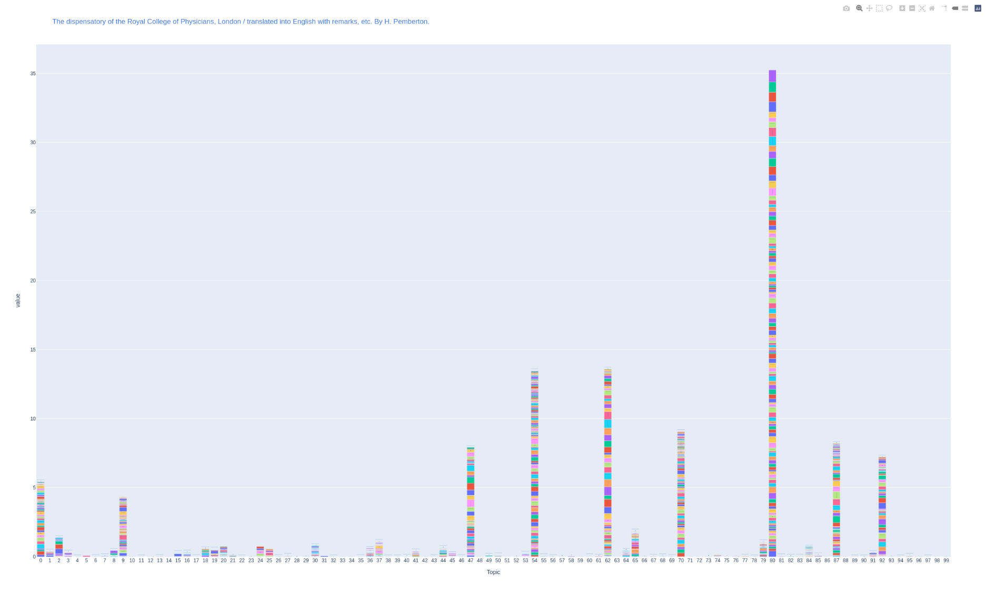
Topics in book chart 1
Notes:
Here are the first 2. They’re not on exactly the same scale, which doesn’t help, but they are pretty similar over the value of 10 – each has 3 topics over 10, two are the same, and in both cases the big spike is topic 80

Slide 29
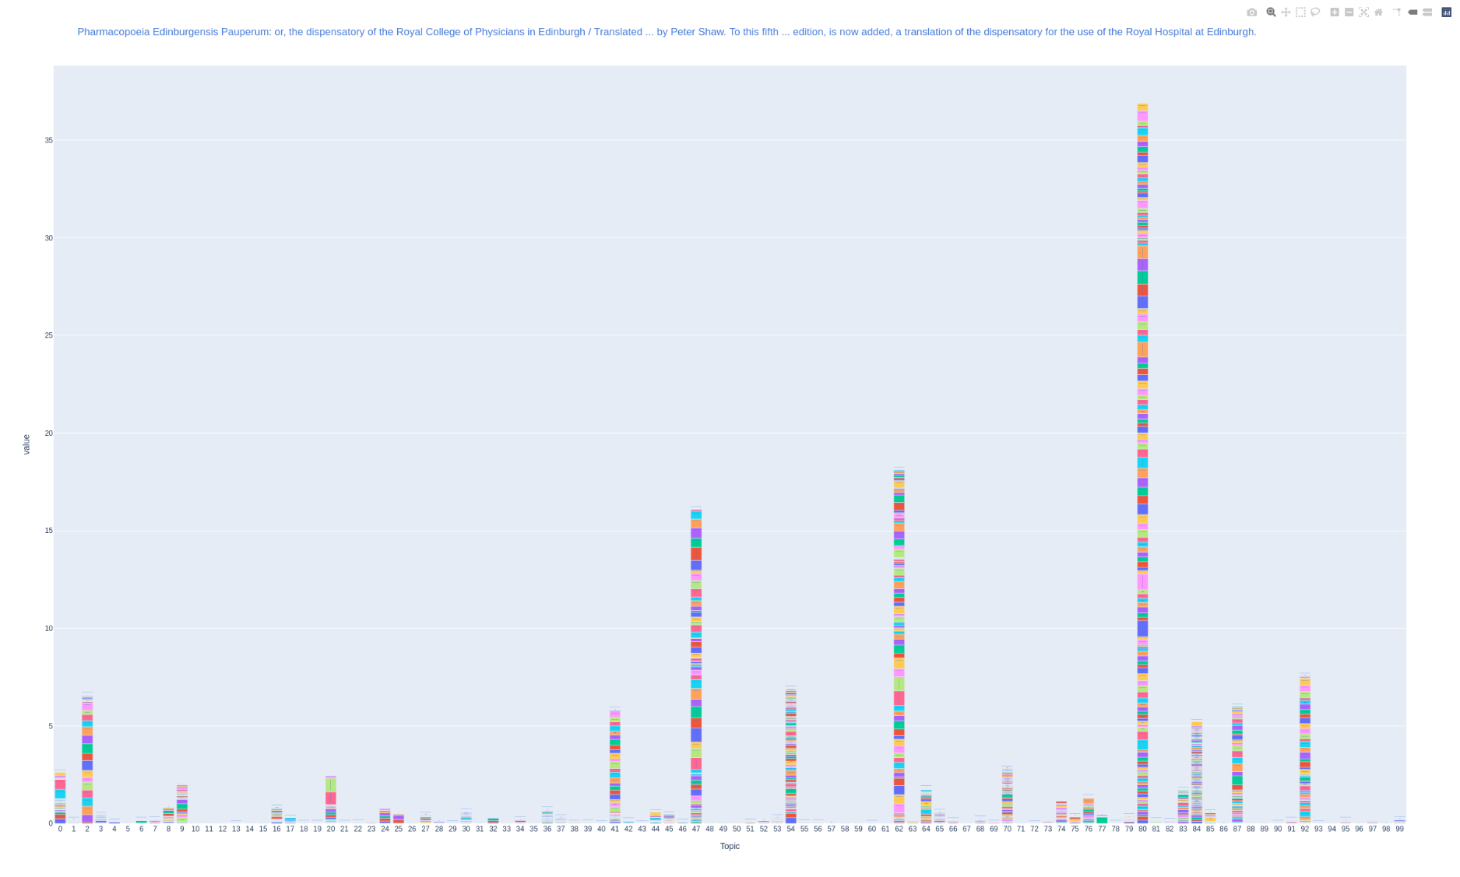
Topics in book chart 2
Notes:
By the “wiggling back and forth” method, we can see that there is quite a bit of difference in these graphs
But the “main” topic is 80 in both cases
And topic 62 is over 10 in both of them

Slide 30
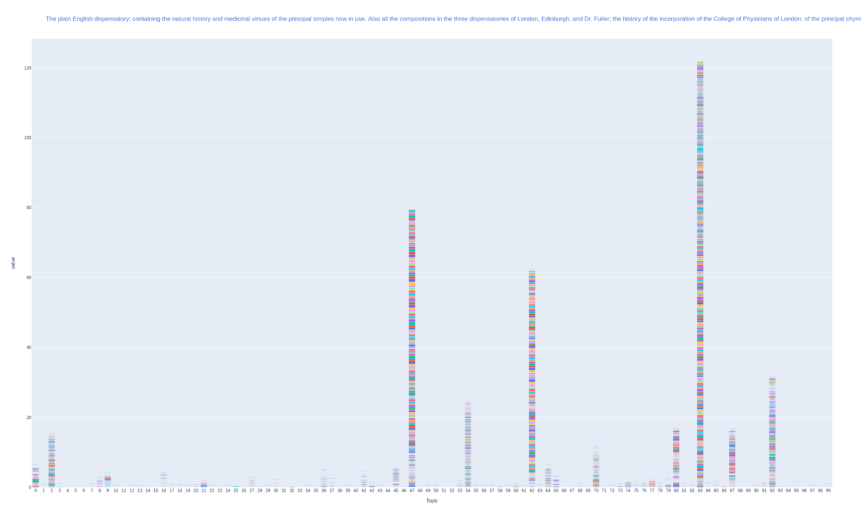
Topics in book chart 3
Notes:
Then with the two that are actually the same book we would expect a very high level of similarity, if everything is working as it should
Again, the scales are slightly different from one another
They are also completely different scale from the previous graphs!
But if I wiggle them back and forward, you can see at least above the 20 line around the bottom there, it doesn’t change massively

Slide 31
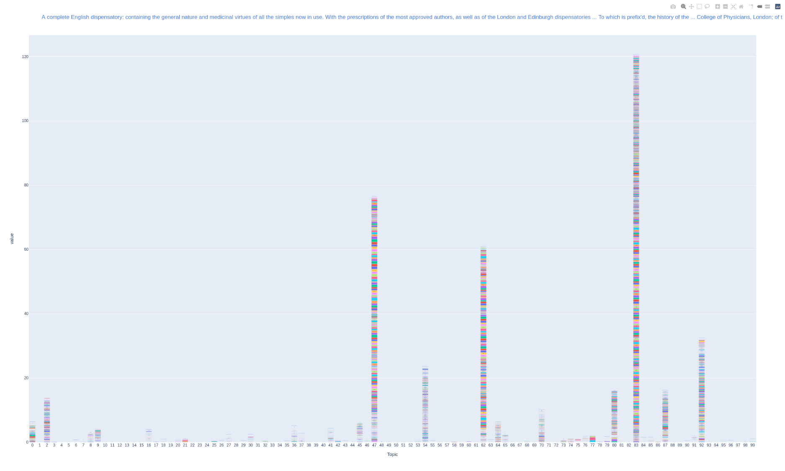
Topics in book chart 4
Notes:
So there’s a bit of movement, but these are very very similar, as we would expect
So that’s kind of reassuring
And across the 4 texts, there is some agreement on what the most important topics are.
Just looking at the highest few texts in each topic
Topic 62 is always high, but never the main topic
Topic 47 is high in the 2 Colborne texts and one of the others
But does it help us at all for search?
The way I would imagine this working is that we find a text of interest
Look at the other topics that are high for that text
And see whether different topics lead us to different texts (or different passages of text)
For now let’s just look at what those top topics are and whether they make sense

Slide 32
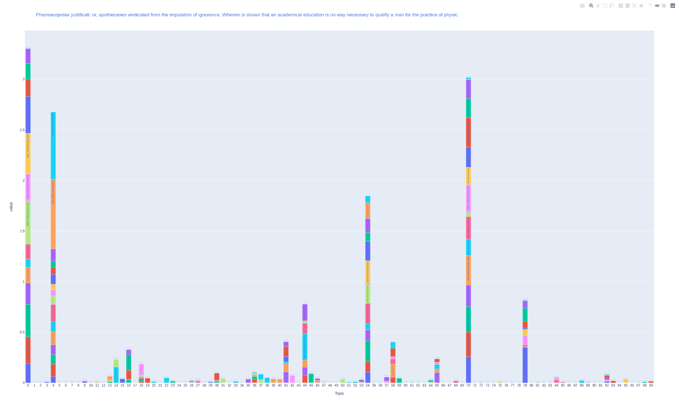
“Confirming” Difference
Notes:
I said before that there were no pharmacopoeia to add
This was half true – there was this one thing, “Pharmacopolae justificati: Apothecaries vindicated from the imputation of ignoranace”
Pharmacopolae being Greek for apothecaries – I misread the title as pharmacopoiae but the subtitle sounded like a polemic so I left it out of the analysis
But then I thought it would be interesting to see if the topic profile would suggest that it was “about something different”
Which it does seem to [wiggle method again]
But the shape of these chunks – few and large – also suggests a shorter text
I’d have to look on the computer in Kew to confirm, but the catalogue says 31 pages
So text length is another variable that can affect interpretation of these visualisations

Slide 33
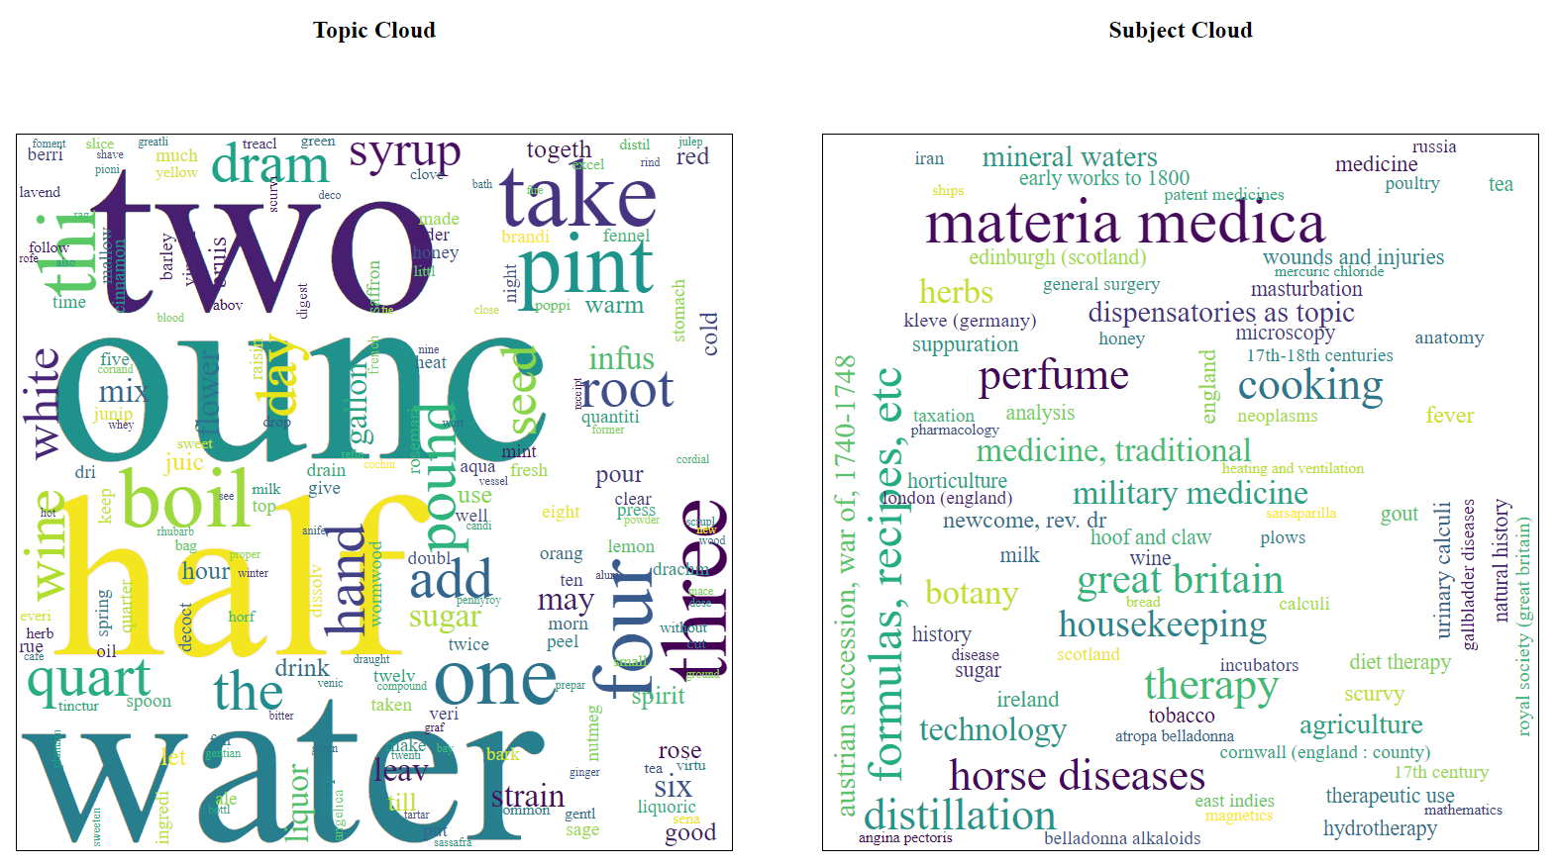
Topic 62
Notes:
Back to the dispensatories -- here’s topic 62, important in all of 4 of those texts
I feel like it looks about as we might expect

Slide 34
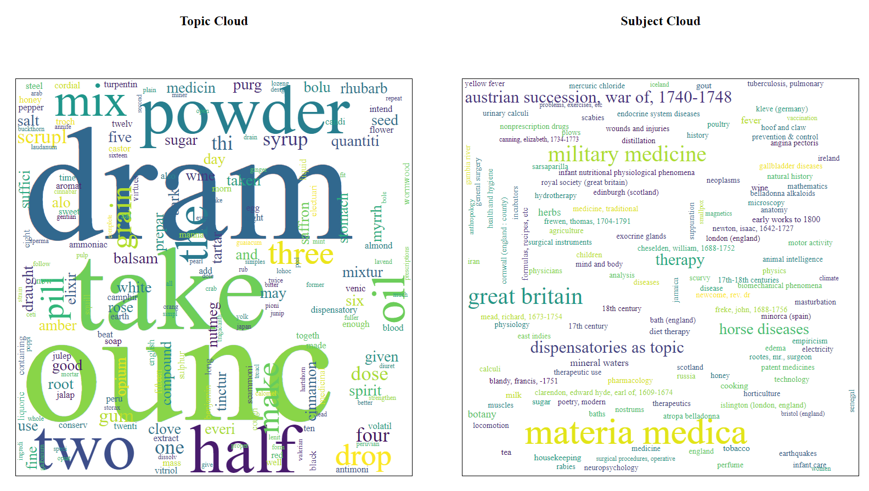
Topic 47
Notes:
Topic 47, high in all but one text (and actually fairly high even in the odd one out)
The topic cloud is similar, but the subject cloud is a little different
Both are large on “materia medica”, but the next size down is perhaps more domestic in topic 62, more military here

Slide 35
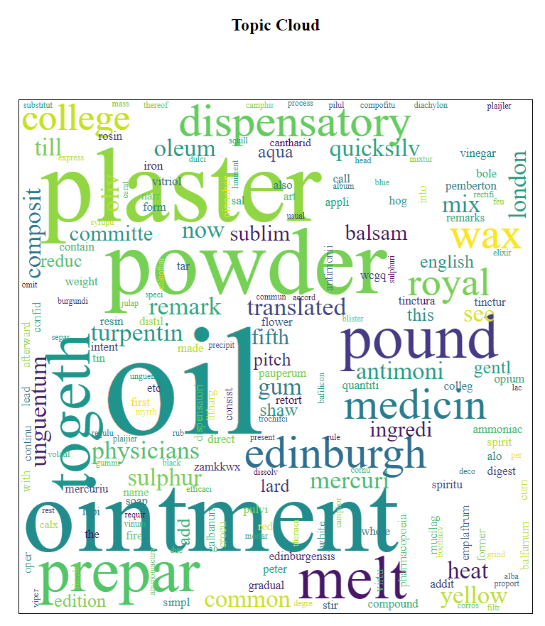
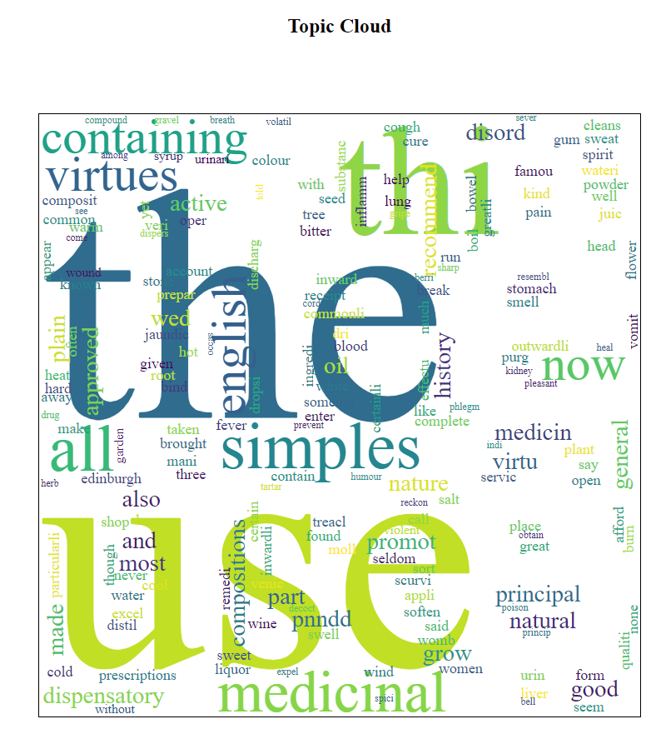
“Main” Topics
80
83
Notes:
The biggest topic was 80 for each of the first two texts, 83 for the two Colborne texts
Topic 80 looks right. Perhaps more focused on the “things made” than on “how to make them”?
Topic 83 is pretty bland. I couldn’t cram it on to the slide, but it’s also one of those ones with a very plain Subject Cloud

Slide 36
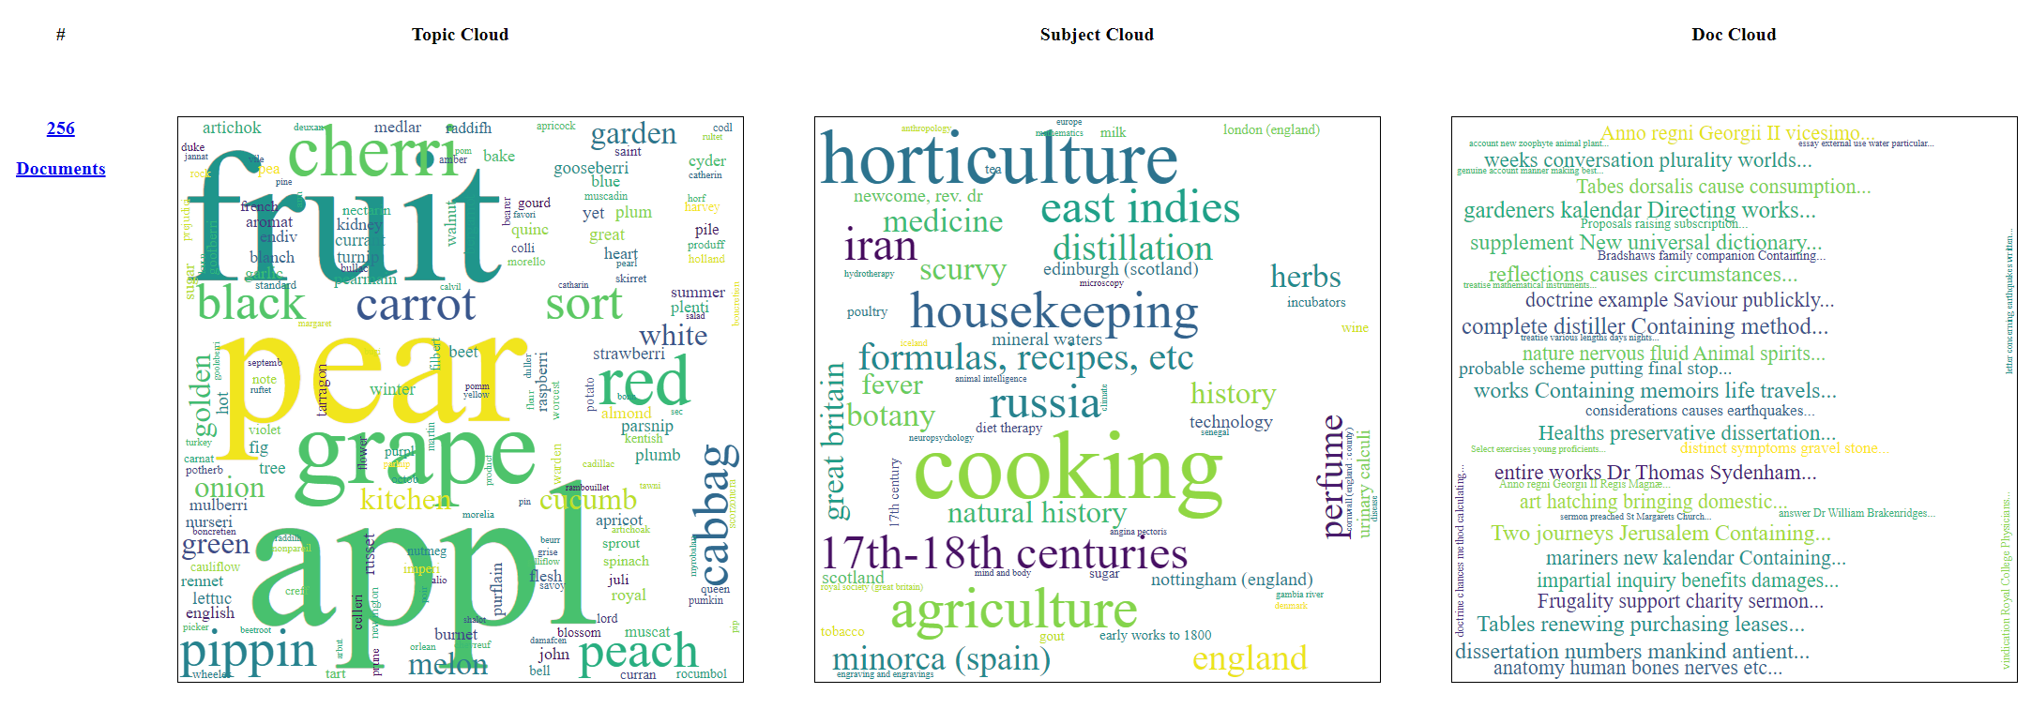
Looking for age [if time!]
Notes:
That seemed, mostly, to make some sort of sense
Perhaps it has some value for exploring the corpus
But it hasn’t really helped with the goal of searching for a particular theme
Obviously this isn’t age
But this topic does look like it could be an example of the sort of thing I wanted to achieve
If I was writing a history of fruit, I might be interested in finding a range of texts that deal with it, of different types
This subject cloud suggests I might find at least cookbooks and horticulture books
The document cloud seems to show a range of types of titles
And finding the specific parts of those texts that deal with it
And a way of searching for the concept of “fruit”, rather than individual words
So I was pleased to come across this one... although LLM-based techniques may turn out to be a better way of doing this sort of thing
And I haven’t actually dived into this topic to see where it would go... I still want to see whether I can tease out anything about age

Slide 37
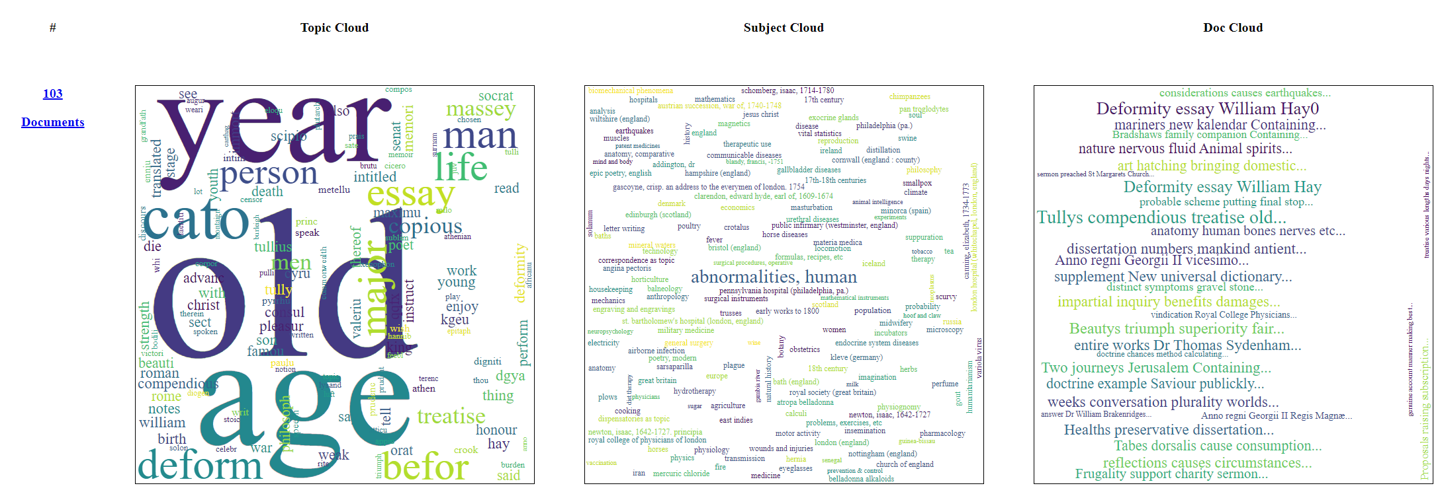
Age 1
Notes:
A few things I could try here
The simplest is searching all topics for the word “age”
More sophisticated would be to search for a range of words
Or to start with known relevant books, or passages from books, and see what else shows up in the same topics as them
“Tully’s compendious treatise of old age” might be worth a look, for example
Time being short, I’ve just done the simplest, and that quite briefly
Found topics where “age” is a “reasonably big word”
And the topic generally looked like the correct sense of age (as opposed to, say, “period of historical time”)
The approach found 3 topics to look at... which given that I’m just in the 1750s feels promising... but are they of any actual value?
This is definitely the most promising one at first glance... but seems very much dominated by “Tully’s compendious treatise of old age”
Which is a translation of Circero so not very directly relevant to early modern notions of old age
Though I suppose there could be something in the introduction
And its nice that this method found it
And possible that the book could serve as a starting point for further search

Slide 38
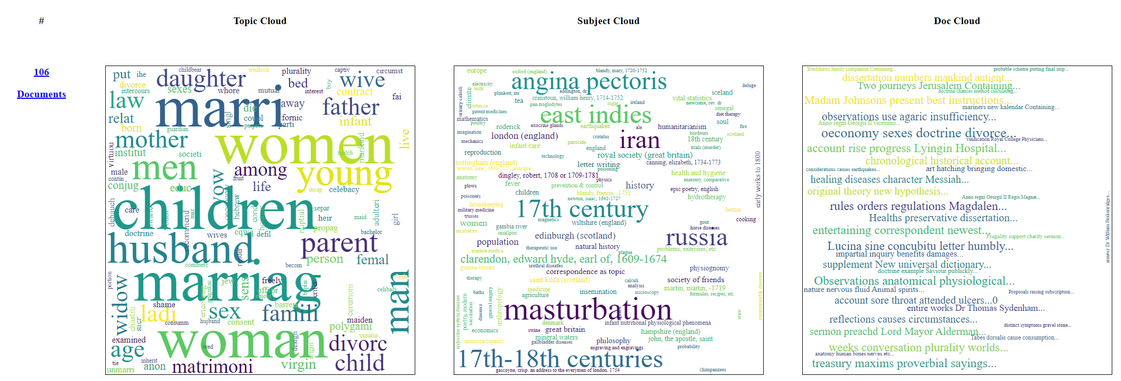
Age 2
Notes:
Age was smaller here, but in a context that looks like it might be “family life” could be of interest
Though the subject cloud perhaps speaks to studies of family life in other cultures??
A single book, “The oeconomy of the sexes. Or the doctrine of divorce, the plurality of wives, and the vow of celebacy freely examined / [Anon].” seems to be dominant
The first few passages seem to be about Jewish divorce
Searching the available passages for “age” does turn up a reference to conjugal relations among older Biblical characters; a mention of men tending to fail to think of “the creature [they] we enamoured of as subject to ...age” being a cause of unhappiness in marriage... but nothing much

Slide 39
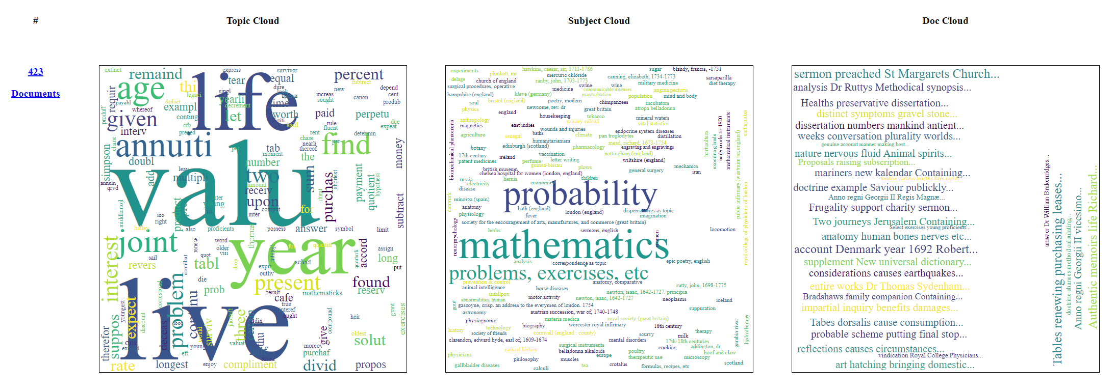
Age 3
Notes:
The subject cloud of this one suggests that we might be more in the area of actuarial tables
There is a text of this form in the corpus, which I stumbled across when exploring one of the coarser views
This one seems to be largely from a textbook of math exercises – it turns out that chapter 6 is about “The valuation of annuities for single and joint lives”
So perhaps not what we’re interested in... though maybe the mathematical angle on age could be of some interest, especially if this is an important period for life insurance/probability
And assuming that what is being discussed here really is human life and not some way of talking about the lifetime of a contract of something... but it does read like human life
There is at least one other book towards the top of the table
The document cloud seems to suggest a broader range of texts... I don’t really trust the document cloud, but perhaps it is worth a look
There is more I could do to investigate these topics, but time is ever short...

Slide 40
Exercise: Exploring the 1750s
Notes:
So this is a much more free-form exercise
Please just have a look around the interface
No explicit goal this time
If you manage to find references to something interesting across a few different texts then that would be very pleasing
And I’d suggest picking just one “topic count” to explore
But just explore as the spirit moves you
If you have a question in mind then by all means have a go

Slide 41
Exploring the 1750s
How might you use a tool like this?
What else you would need to do that properly? e.g.
Different access to the underlying texts
More information about the texts in the cloud
Different tools, interfaces, visualisations
What can you really not do with a tool like this?
Notes:
Here are some things you could think about as you go – could replace “you” here with a particular audience or type of user that you care about

Slide 42
What’s Next?
Back on weeks of 11th and 18th November
On site from Tuesday – Thursday of each week
Workshops on Tuesday 12th and Thursday 14th & 21st
Tuesday 12th: Recap, plans, hands-on
Thursday 14th: Review first week, more hands-on time, paper prototyping
Thursday 21st: Review of visit, reflections
Notes:
So what we have now are some data, some ways of visualizing it
I have some concerns about the meaningfulness of at least some of these ways of visualizing
But there seems to be enough “sense” in what I’m seeing, as in the dispensatories, to reassure me that there is something meaningful happening here
And I still feel like there is something here worth exploring
Will be back in November for an extended final visit
Likely won’t have anything new to show on arrival – I’ve burned through an awful lot of the time allocated for this project!
But will aim to push the whole 18th century corpus through the pipeline, so there will be some better data to work with
If I can find a bit of time then I’ll produce a Wellcome-only version, too
Data processing is slow, so the focus will need to be on using the data we have
Exploring how to analyze and effectively visualize it
To search for material relevant to aging
But also on other uses of interest, like classification or exploration

Slide 43
Thank you
Bernard Ogden
The National Archives
Kew, Richmond
TW9 4DU

